Slide 1
Links

Slide 2
Hyperlinks connect web pages
Hyperlinks point to hypertext documents
Allow viewers to click from page to page
example

Slide 3
Making a Hyperlink
Click Me Click Me

Slide 4
Making a Hyperlink
Click Me Click Me
???

Slide 5
The <a> Tag
The <a> tag allows us to define a hyperlink in HTML

Slide 6
Structure of a Link
Click Me
Preview
Click Me

Slide 7
Structure of a Link
<a href="https://google.com">
Click Me
</a>
Preview
Click Me

Slide 8
Structure of a Link
<a href="https://google.com">
Click Me
</a>
The text displayed
Preview
Click Me

Slide 9
Structure of a Link
<a href="https://google.com">
Click Me
</a>
Where the link takes you
Preview
Click Me

Slide 10
Structure of a Link
<a href="https://google.com">
Click Me
</a>
We can add text inside the opening tag??
Preview
Click Me

Slide 11
HTML Attributes
Tags can have attributes that tell us more information about the tag

Slide 12
HTML Attributes
<a>

Slide 13
HTML Attributes
<a href="https://google.com">
Attributes go inside the opening tag

Slide 14
HTML Attributes
<a href="https://google.com">
Attributes have a name

Slide 15
HTML Attributes
<a href="https://google.com">
Attributes have a value

Slide 16
HTML Attributes
<a href="https://google.com">
The value goes inside "double quotes"

Slide 17
HTML Attributes
<a href="https://google.com">
General format: name="value"

Slide 18
HTML Attributes
<a href="https://google.com">
General format: name="value"
Example: href="https://google.com"

Slide 19
HTML Attributes
<a href="https://google.com">
General format: name="value"
Example: href="https://google.com"
This tag’s reference (href) is google.com
It links or points to google.com

Slide 20
Structure of a Link
<a href="https://google.com">
Click Me
</a>
Preview
Click Me

Slide 21
Structure of a Link
<a href="https://google.com">
Click Me
</a>
The <a> tag annotates the Click Me text to make it a hyperlink to google
Preview
Click Me

Slide 22
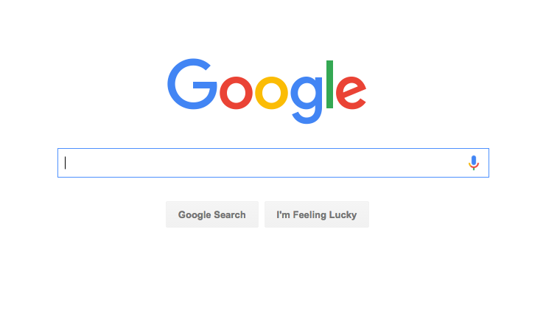
Structure of a Link
<a href="https://google.com">
Click Me
</a>
The <a> tag annotates the Click Me text to make it a hyperlink to google
Preview
Click Me

Slide 23
Let’s see this in the editor!

